Slide 1

课程QQ群

Slide 2
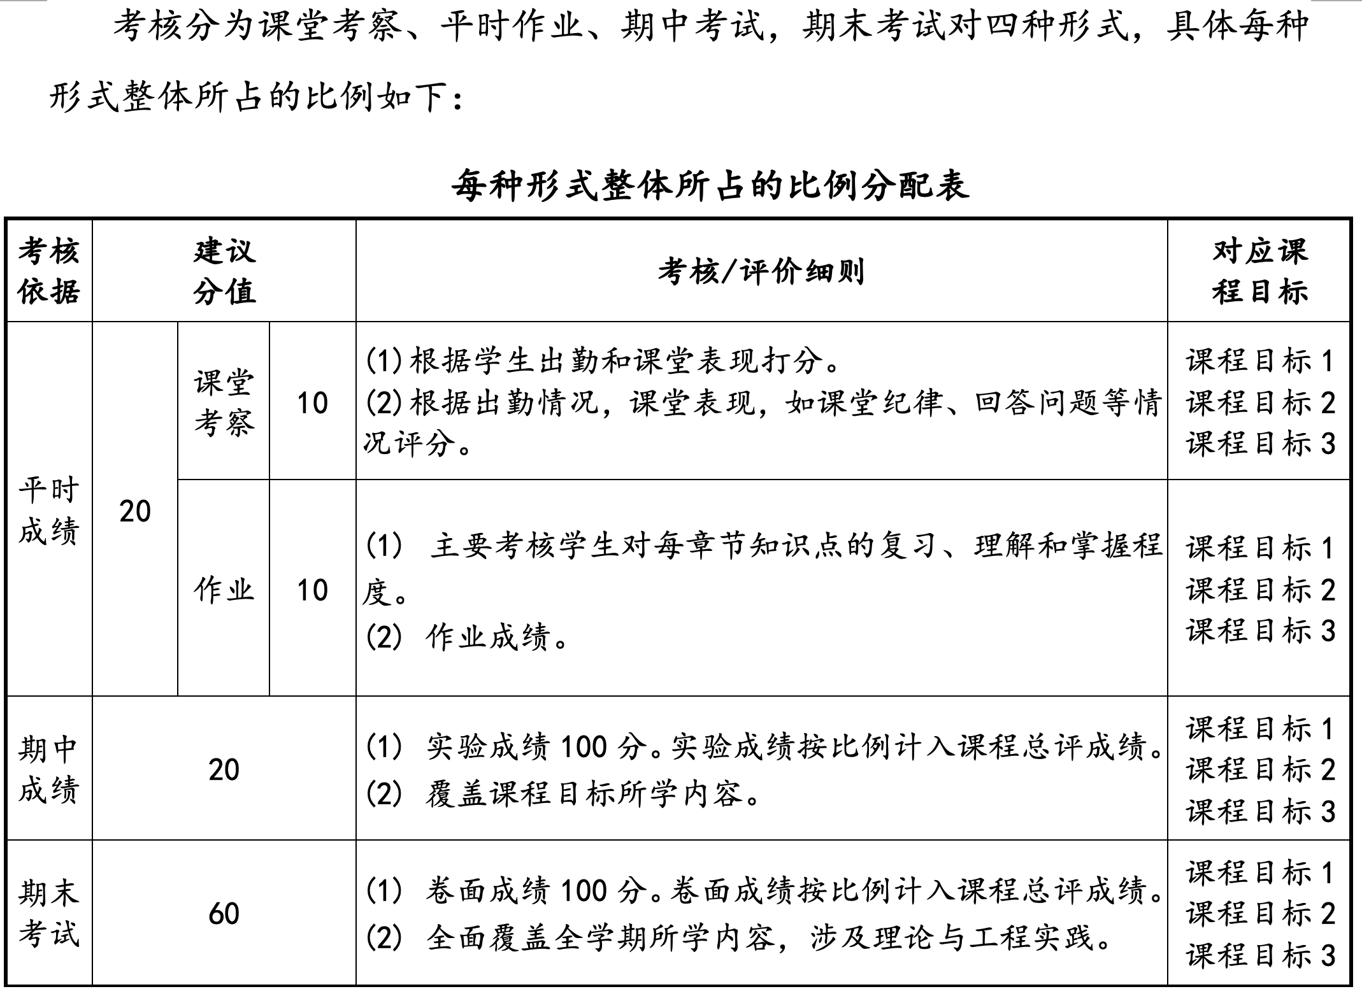
考核方式和成绩评定

Slide 3
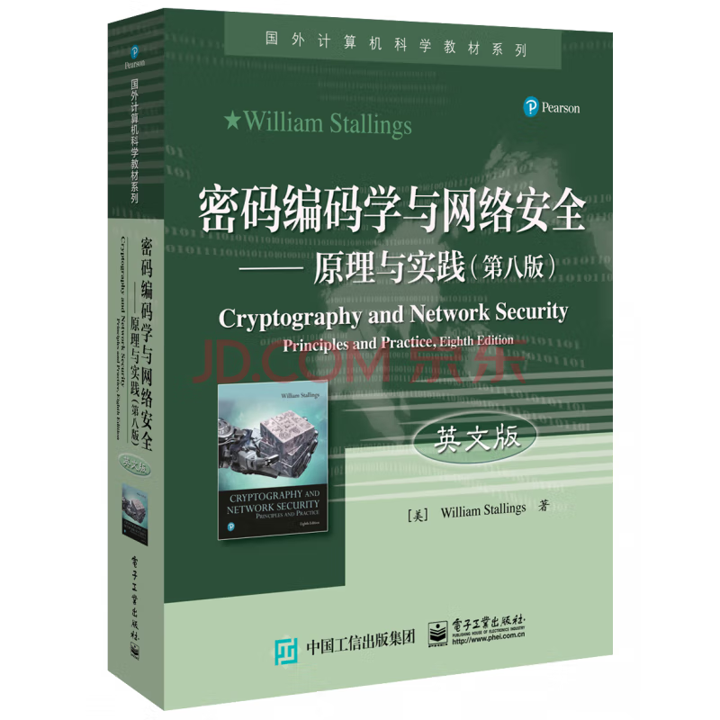

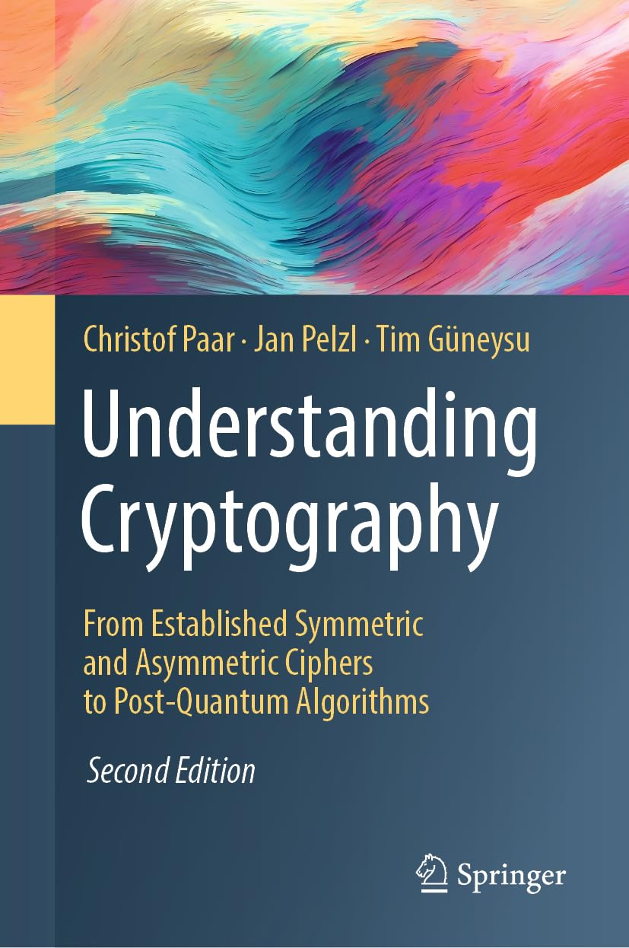
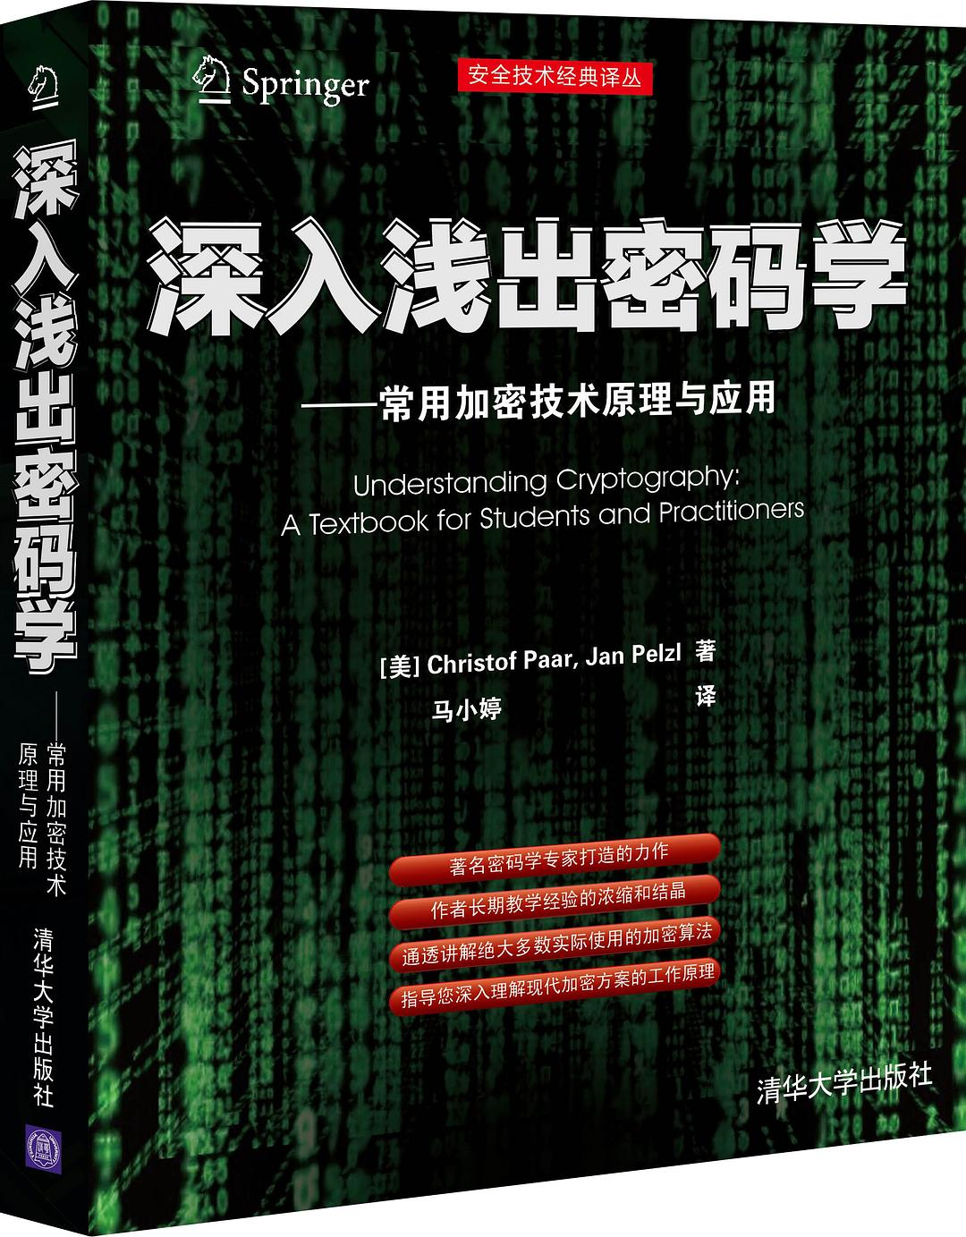
Textbooks

Slide 4

网课：Youtube Channel
https://www.youtube.com/channel/UC1usFRN4LCMcfIV7UjHNuQg/videos

Slide 5
Curiosity, Passion, Love
爱因斯坦：“我没有特殊的天赋，只是拥有热切的好奇心。”
美国哈佛大学教授、数学诺贝尔奖“菲尔兹”奖、沃尔夫数学奖得主——丘成桐教授：“对不懂的事情要有好奇心，对自己选定的目标要有热情。”
Curiosity➡️Passion➡️Love

Slide 6
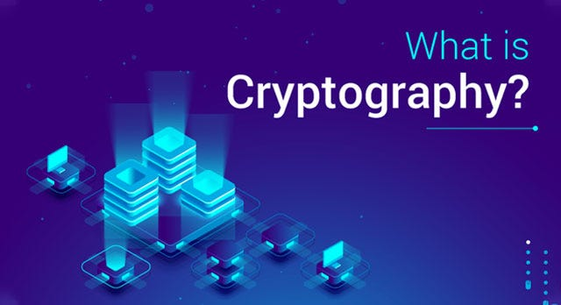
Chapter 1 Introduction

Slide 7
Content of this Chapter
Overview on the field of cryptology
Basics of symmetric cryptography
Substitution Cipher
Cryptanalysis
Modular arithmetic
Shift (or Caesar) Cipher, Vigenere Cipher and Affine Cipher

Slide 8
Content of this Chapter
Overview on the field of cryptology
Basics of symmetric cryptography
Substitution Cipher
Cryptanalysis
Modular arithmetic
Shift (or Caesar) Cipher, Vigenere Cipher and Affine Cipher

Slide 9
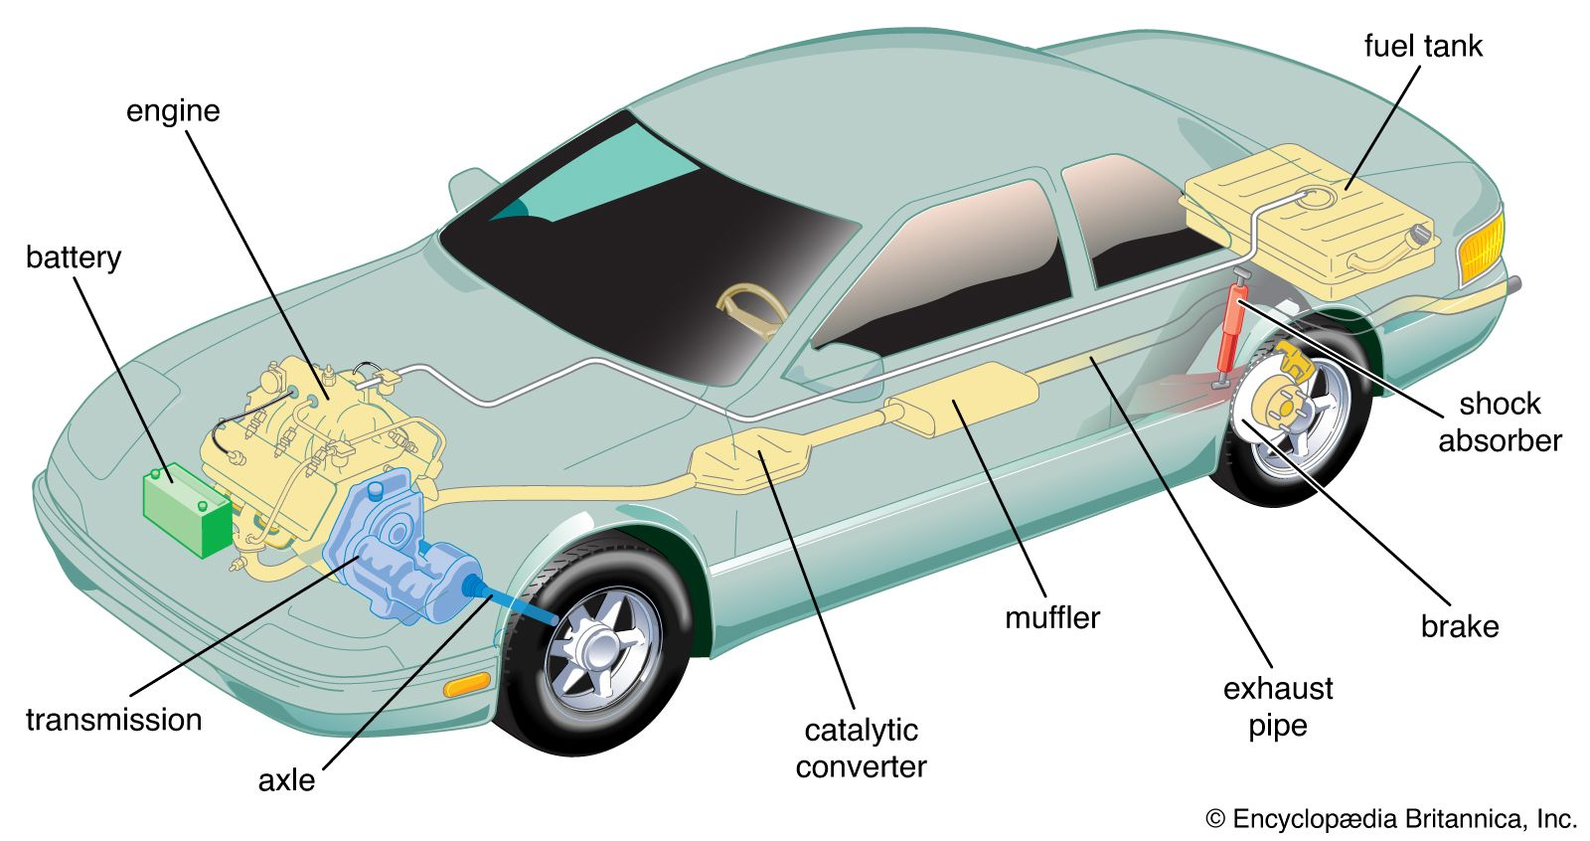
Cryptography and Cybersecurity
If cybersecurity is a Car, cryptography is its engine.
It is hard to build secure digital systems without cryptographic algorithms.

Slide 10
History of Cryptology
2000 B.C. —— 1970s: Classic Cryptography
1970s —— 现在：Modern Cryptography

Slide 11
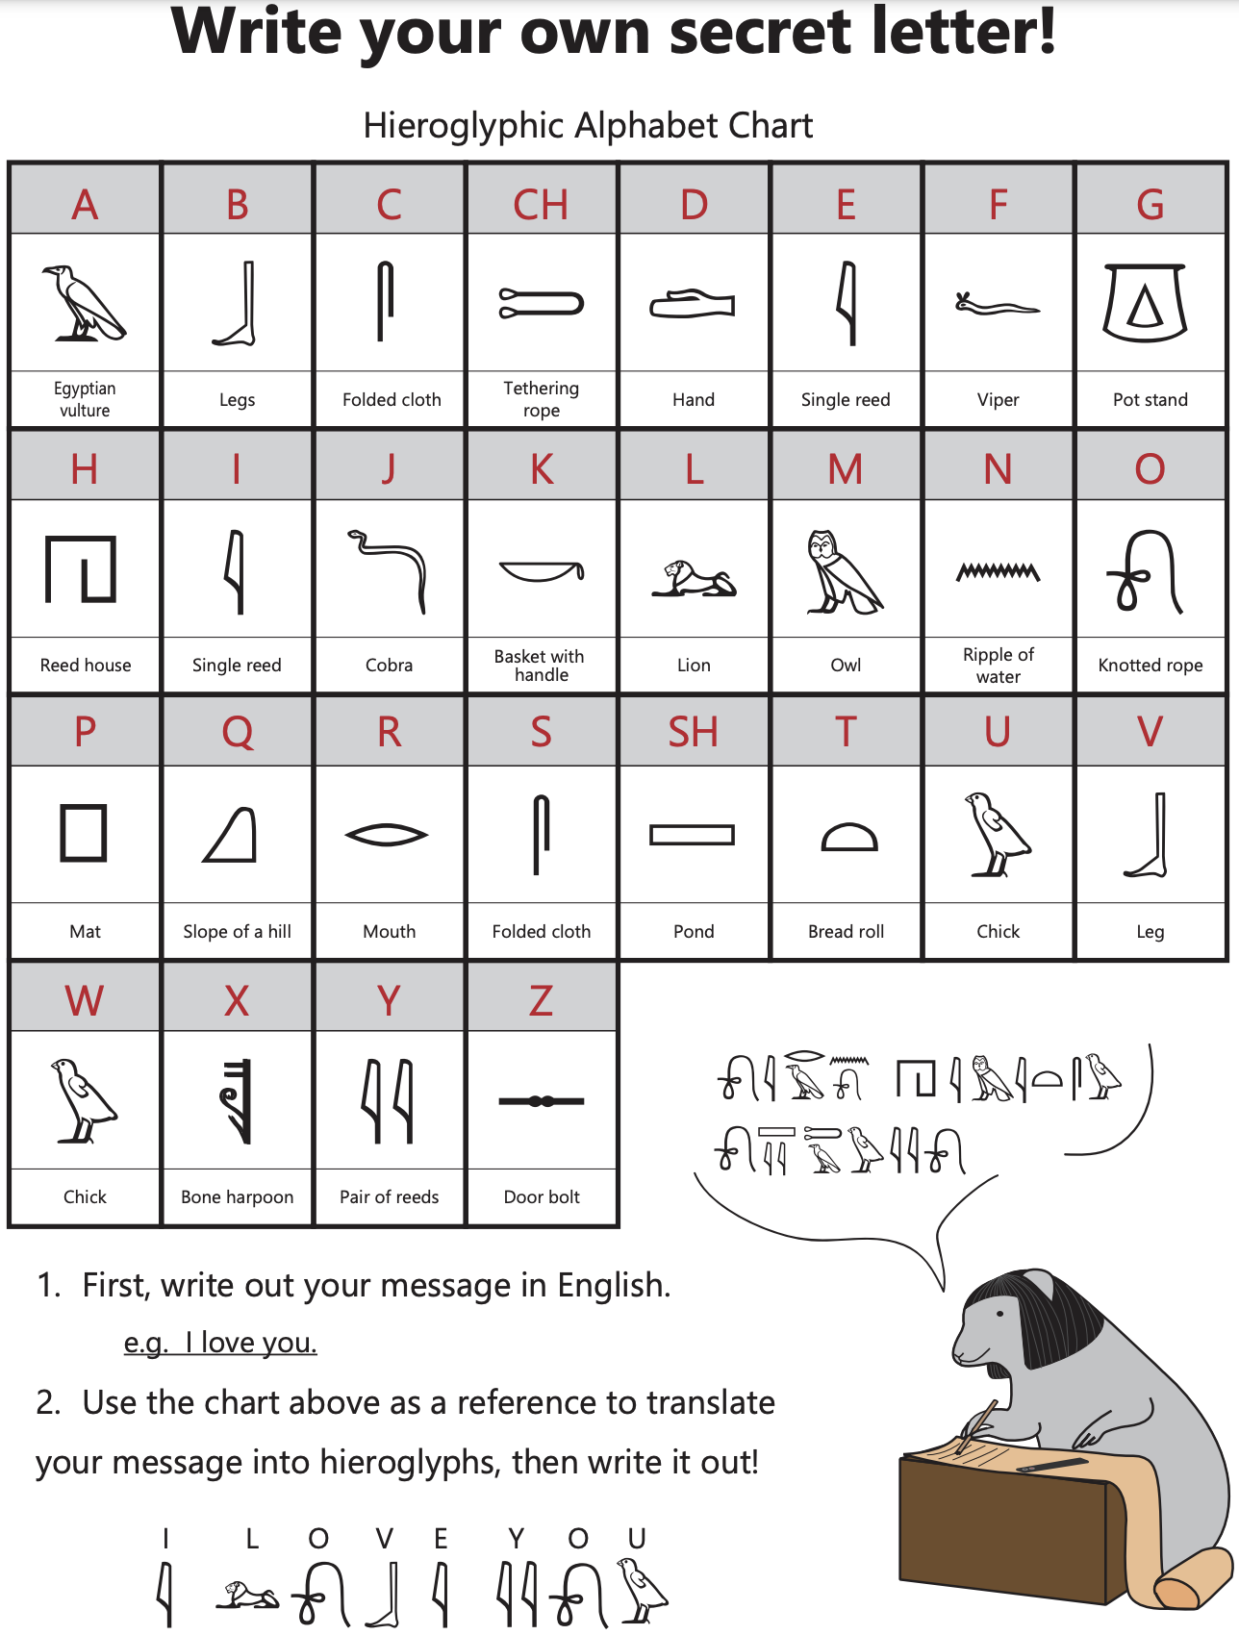
Very long history:
since 2000 B.C. ancient Egypt.

Slide 12
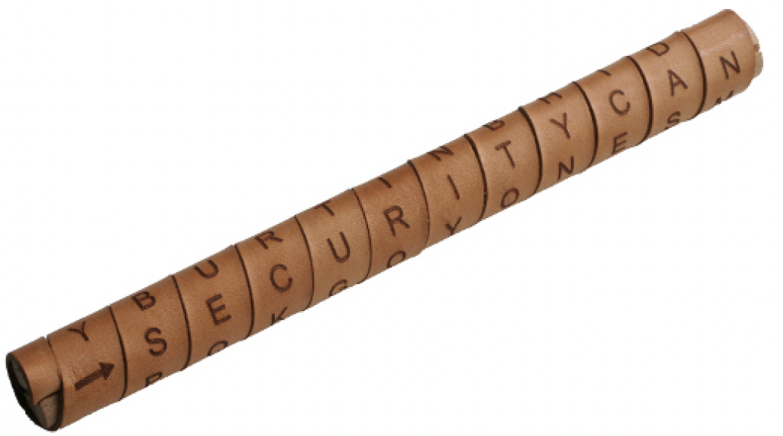
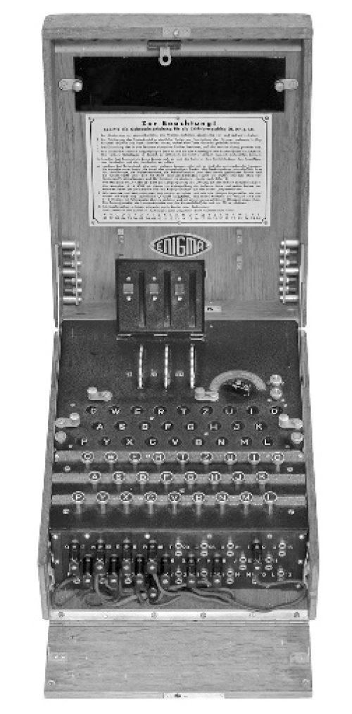
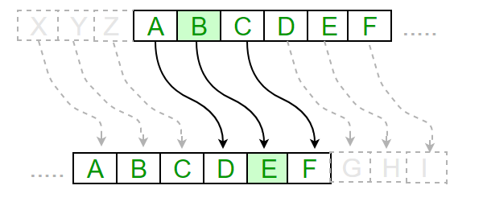
Scytale of Sparta
Ancient Greece
Caesar Cipher
Ancient Rome
The German Enigma encryption machine
World War II

Slide 13
Classification of the Field of Cryptology
Cryptology
Cryptography
Cryptanalysis
Symmetric Ciphers
Asymmetric Ciphers
Protocols
Block Ciphers
Stream Ciphers

Slide 14
Some Basic Facts
Ancient Crypto: Early signs of encryption in Eqypt in ca. 2000 B.C. Letter-based encryption schemes (e.g., Caesar cipher) popular ever since.
Symmetric ciphers: All encryption schemes from ancient times until 1976 were symmetric ones.
Asymmetric ciphers: In 1976 public-key (or asymmetric) cryptography was openly proposed by Diffie, Hellman and Merkle.
Hybrid Schemes: The majority of today‘s protocols are hybrid schemes, i.e., the use both
symmteric ciphers (e.g., for encryption and message authentication) and
asymmetric ciphers (e.g., for key exchange and digital signature).

Slide 15
Content of this Chapter
Overview on the field of cryptology
Basics of symmetric cryptography
Substitution Cipher
Cryptanalysis
Modular arithmetic
Shift (or Caesar) Cipher, Vigenere Cipher and Affine Cipher

Slide 16
Symmetric Cryptography
Alternative names: symmetic-key, single-key or secret-key cryptography.
Oscar (bad guy)
Unsecure channel (e.g. Internet)
Alice (good)
Bob (good)
x
x
Problem Statement: 1) Alice and Bob would like to communicate via an unsecure channel (e.g., WLAN or Internet). 2) A malicious third party Oscar (the bad guy) has channel access but should not be able to understand the communication.

Slide 17
Symmetric Cryptography
Solution: Encryption with symmetric cipher. ⇒ Oscar obtains only ciphertext y, that looks like random bits
Oscar (bad guy)
Unsecure channel (e.g. Internet)
y
Alice (good)
Encryption e( )
Decryption d( )
Bob (good)
x
y
x
K
K
Key Generator
Secure Channel
x is the. plaintext
y is the ciphertext
K is the key
Set of all keys {K1, K2, ...,Kn} is the key space

Slide 18
Symmetric Cryptography
Encryption equation y = e_{K}(x)
Decryption equation x = d_{K}(y)
Encryption and decryption are inverse operations if the same key K is used on both sides:
d_{K}(y) = d_{K}(e_{K}(x)) = x
Important: The key must be transmitted via a secure channel between Alice and Bob.
The secure channel can be realized, e.g., by manually installing the key for the Wi-Fi Protected Access (WPA) protocol or a human courier.
However, the system is only secure if an attacker does not learn the key K!
⇒ The problem of secure communication is reduced to secure transmission and storage of the key K.

Slide 19
Content of this Chapter
Overview on the field of cryptology
Basics of symmetric cryptography
Substitution Cipher
Cryptanalysis
Modular arithmetic
Shift (or Caesar) Cipher, Vigenere Cipher and Affine Cipher

Slide 20
Substitution Cipher
Historical cipher
Great tool for understanding brute-force vs. analytical attacks
Encrypts letters rather than bits (like all ciphers until after WW II)
Idea: replace each plaintext letter by a fixed other letter.
Plaintext Ciphertext
A → k
B → d
C → w
....
for instance, ABBA would be encrypted as kddk
Example (ciphertext):
iq ifcc vqqr fb rdq vfllcq na rdq cfjwhwz hr bnnb hcc hwwhbsqvqbre hwq vhlq
How secure is the Substitution Cipher? Let‘s look at attacks…

Slide 21
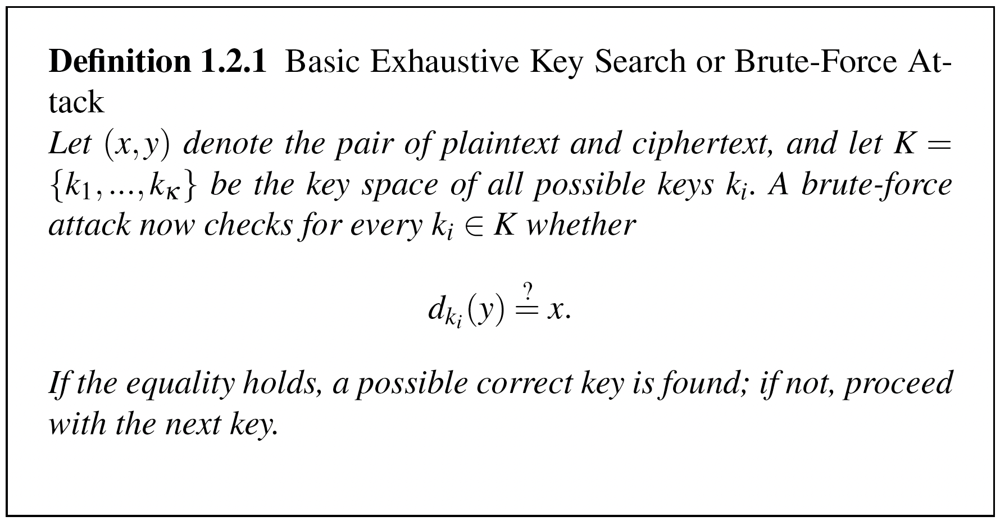
Frist Attack: Brute-Force Attack (or Exhaustive Key Search)
Treats the cipher as a black box
Requires (at least) 1 plaintext-ciphertext pair (x₀, y₀)
Check all possible keys until condition is fulfilled: d_{K}(y₀) = x₀
?
Notes:
For applications with long term security needs, 128 bit keys should be considered. For thwarting against attacks with to-be-developed quantum computers, 256 bits are believed to be appropriate. Since a longer key usually does no carry a performance penality for symmetric algorithms, it is a prudent choice to use ciphers with a key lengths of around 128 bits.

Slide 22
Brute-Force Attack
Attack: Exhaustive Key Search (Brute-Force Attack)
Simply try every possible subsititution table until an intelligent plaintext appears (note that each substitution table is a key)..
How many substitution tables (= keys) are there?
26 x 25 x … x 3 x 2 x 1 = 26! ≈ 2⁸⁸
Search through 2⁸⁸ keys is completely infeasible with today‘s computers! (cf. earlier table on key lengths)
Q: Can we now conclude that the substitution cipher is secure since a brute-forece attack is not feasible?
A: No! We have to protect against all possible attacks…
Notes:
The major weakness of the method is that each plaintext symbol always maps to the same ciphertext symbol. That means that the statistical properties of the plaintext are preserved in the ciphertext. For practical attacks, the following properties of language can be exploited:
Determine the frequencies of every ciphertext letter. The frequency distribution (even of relatively short pieces of encrypted text) will be close to that of the given language in general. In particular, the most frequent letters (for instance, in English: „e“ is the most frequent one with about 13%, „t“ is the second most frequent one with about 9%, „a“ is the third most frequent one with about 8%, ...) can often easily be spotted in ciphertext.
The method above can be generalized by looking at pairs (or triples, or quadruples, or ...) of ciphertext symbols. For instance, in English (and German and other European languages), the letter „q“ is almost always followed by a „u“. This behavior can be exploited for detecting the substitution of the letter „q“ and the letter „u“.
If we assume that word separators (blanks) have been found (which is often an easy task), one can often detect frequent short words such as „the“, „and“, ... , which leaks all the letters in the words involved in those words

Slide 23
Second Attack: Letter Frequency Analysis
Letters have very different frequencies in the English language
Moreover: the frequency of plaintext letters is preserved in the ciphertext.
For instance, “e” is the most common letter in English; almost 13% of all letters in a typical English text are “e”.
The next most common one is “t” with about 9%.
Notes:
The major weakness of the method is that each plaintext symbol always maps to the same ciphertext symbol. That means that the statistical properties of the plaintext are preserved in the ciphertext. For practical attacks, the following properties of language can be exploited:
Determine the frequencies of every ciphertext letter. The frequency distribution (even of relatively short pieces of encrypted text) will be close to that of the given language in general. In particular, the most frequent letters (for instance, in English: „e“ is the most frequent one with about 13%, „t“ is the second most frequent one with about 9%, „a“ is the third most frequent one with about 8%, ...) can often easily be spotted in ciphertext.
The method above can be generalized by looking at pairs (or triples, or quadruples, or ...) of ciphertext symbols. For instance, in English (and German and other European languages), the letter „q“ is almost always followed by a „u“. This behavior can be exploited for detecting the substitution of the letter „q“ and the letter „u“.
If we assume that word separators (blanks) have been found (which is often an easy task), one can often detect frequent short words such as „the“, „and“, ... , which leaks all the letters in the words involved in those words

Slide 24
Breaking the Substitution Cipher with Letter Frequency Attack
Let‘s retun to our example and identify the most frequent letter:
iq ifcc vqqr fb rdq vfllcq na rdq cfjwhwz hr bnnb hcc hwwhbsqvqbre hwq vhlq
We replace the ciphertext letter q by E and obtain:
iE ifcc vEEr fb rdE vfllcE na rdE cfjwhwz hr bnnb hcc hwwhbsEvEbre hwE vhlE
By further guessing based on the frequency of the remaining letters we obtain the plaintext:
WE WILL MEET IN THE MIDDLE OF THE LIBRARY AT NOON ALL ARRANGEMENTS ARE MADE

Slide 25
Breaking the Substitution Cipher with Letter Frequency Attack
In practice, not only frequencies of individual letters can be used for an attack, but also the frequency of letter pairs (i.e., “th” is very common in English), letter triples, etc.
cf. Problem 1.1 in Understanding Cryptography for a longer ciphertext you can try to break!
Important lesson: Even though the substitution cipher has a sufficiently large key space of appr. 2⁸⁸, it can easily be defeated with analytical methods. This is an excellent example that an encryption scheme must withstand all types of attacks.

Slide 26
Content of this Chapter
Overview on the field of cryptology
Basics of symmetric cryptography
Substitution Cipher
Cryptanalysis
Modular arithmetic
Shift (or Caesar) Cipher, Vigenere Cipher and Affine Cipher

Slide 27
Why do we need Cryptanalysis?
Cryptanalysis is of central importance for modern cryptosystems: without people who try to break our crypto methods, we will never know whether they are really secure or not.
Kerckhoff‘s Principle is paramount in modern cryptography:
A cryptosystem should be secure even if the attacker (Oscar) knows all details about the system, with the exception of the secret key.
In order to achieve Kerckhoff‘s Principle in practice: Only use widely known ciphers that have been cryptanalyzed for several years by good cryptographers! (Understanding Cryptography only treats such ciphers)
Remark: It is tempting to assume that a cipher is “more secure“ if its details are kept secret. However, history has shown time and again that secret ciphers can almost always been broken once they have been reversed engineered. (Example: Content Scrambling System (CSS) for DVD content protection.)

Slide 28
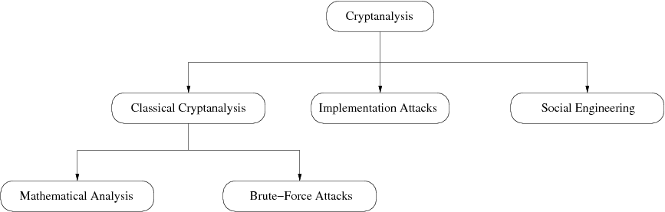
Cryptanalysis: Attacking Cryptosystems
Classical Attacks
Mathematical Analysis
Brute-Force Attack
Implementation Attack: Try to extract key through reverese engineering or power measurement, e.g., for a banking smart card.
Social Engineering: E.g., trick a user into giving up her password

Slide 29
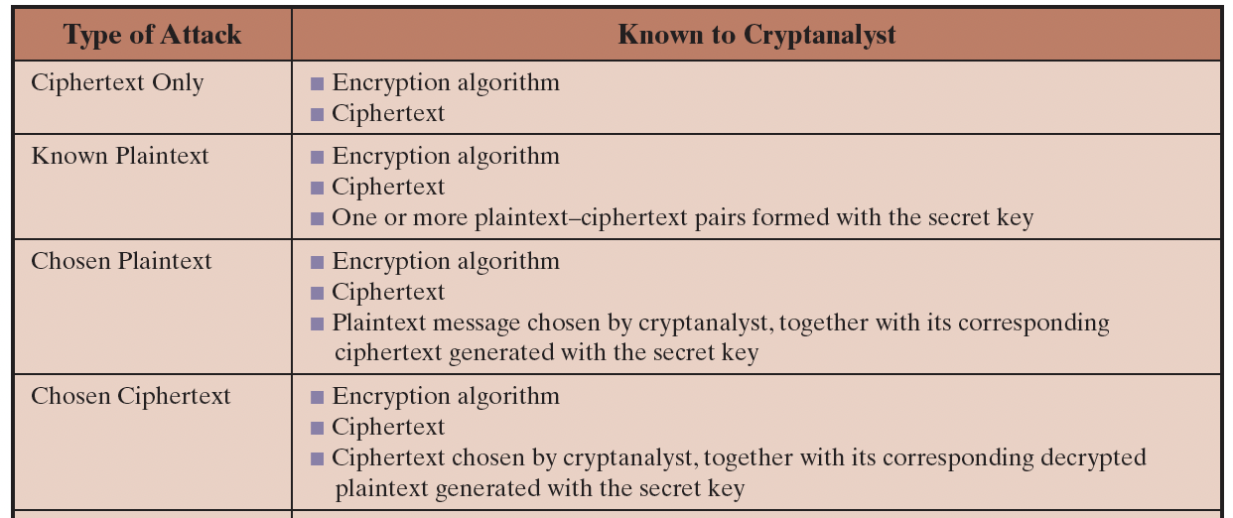
Classes of classical attacks

Slide 30
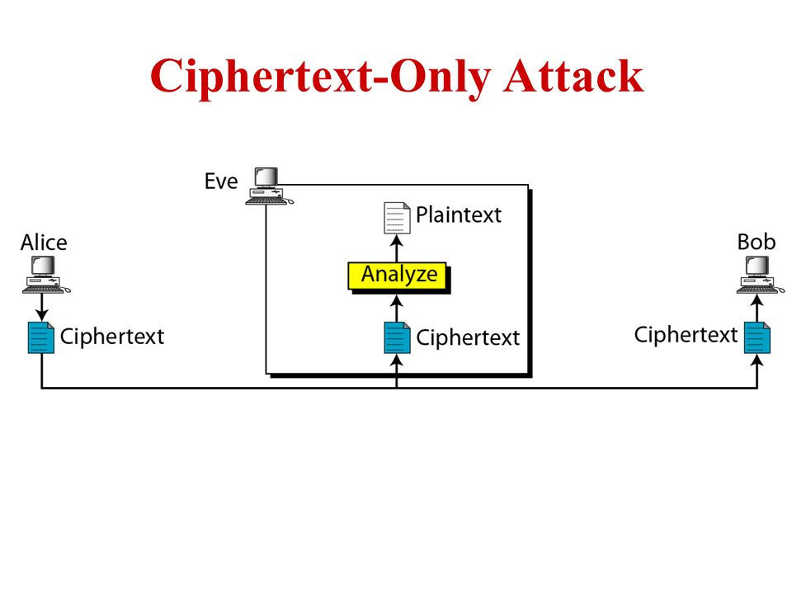

Slide 31
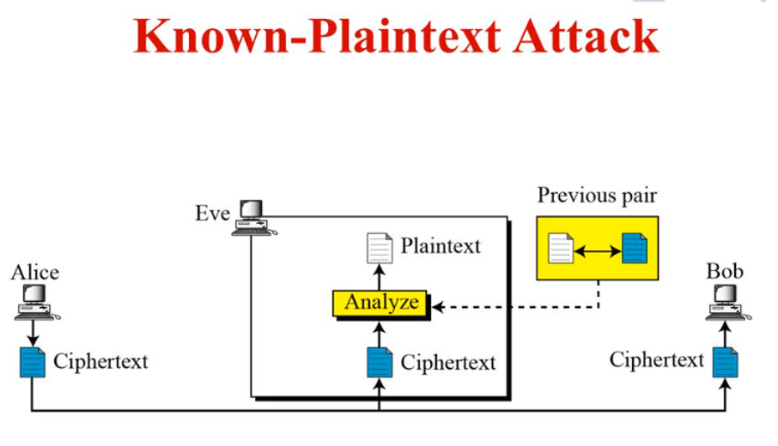
Notes:
(1)Email Header: From:
(2)Headers of well-known protocols: HTTP 1.1

Slide 32
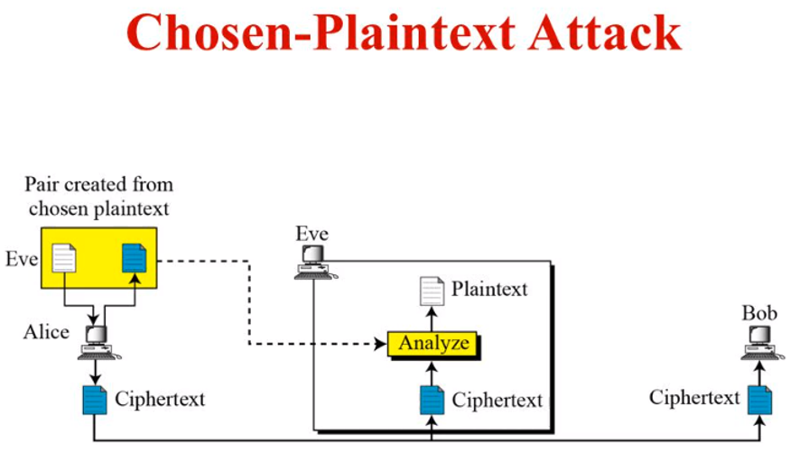
Notes:
The famous cryptanalysis story involving the Battle of Midway.

Slide 33
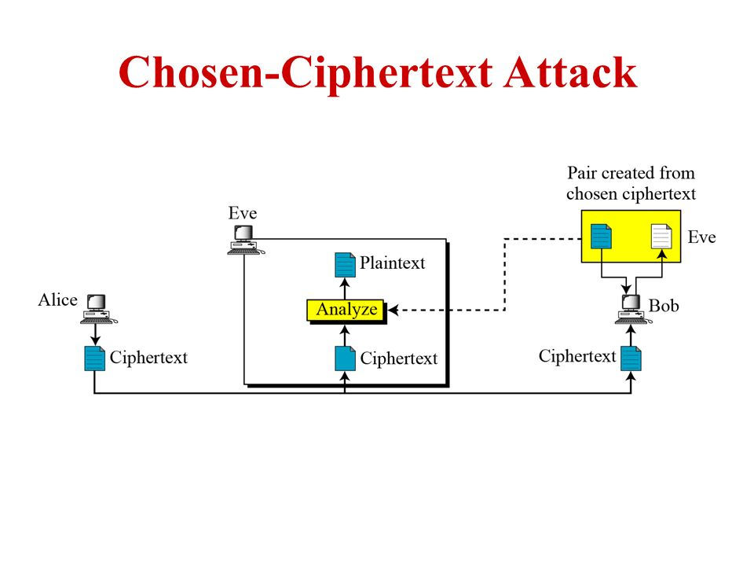
Notes:
Bleichenbacher's padding-oracle attacks on RSA with PKCS #1 v1.5 padding

Slide 34
How Many Key Bits Are Enough?
Key length in bit | Key space | Security life time (assuming brute-force as best possible attack)
64 | 2⁶⁴ | Short term (a few hours or days)
128 | 2¹²⁸ | Long-term (several decades in the absence of quantum computers)
256 | 2²⁵⁶ | Long-term (several decades, even with quantum computers)
Important: An adversary only needs to succeed with one attack. Thus, a long key space does not help if other attacks (e.g., social engineering) are possible..
Notes:
For applications with long term security needs, 128 bit keys should be considered. For thwarting against attacks with to-be-developed quantum computers, 256 bits are believed to be appropriate. Since a longer key usually does no carry a performance penality for symmetric algorithms, it is a prudent choice to use ciphers with a key lengths of around 128 bits.

Slide 35
Content of this Chapter
Overview on the field of cryptology
Basics of symmetric cryptography
Substitution Cipher
Cryptanalysis
Modular arithmetic
Shift (or Caesar) Cipher, Vigenere Cipher and Affine Cipher

Slide 36
Short Introduction to Modular Arithmetic
Why do we need to study modular arithmetic?
Extremely important for asymmetric cryptography (RSA, elliptic curves etc.)
Some historical ciphers can be elegantly described with modular arithmetic (cf. Caesar and affine cipher later on).

Slide 37
Short Introduction to Modular Arithmetic
Generally speaking, most cryptosytems are based on sets of numbers that are
discrete (sets with integers are particularly useful)
finite (i.e., if we only compute with a finiely many numbers)
Seems too abstract? --- Let‘s look at a finite set with discrete numbers we are quite familiar with: a clock.
12
11
1
10
2
9
3
8
4
7
5
6
Interestingly, even though the numbers are incremented every hour we never leave the set of integers:
1, 2, 3, … 11, 12, 1, 2, 3, … 11, 12, 1, 2, 3, …:

Slide 38
Short Introduction to Modular Arithmetic
We develop now an arithmetic system which allows us to compute in finite sets of integers like the 12 integers we find on a clock (1,2,3, … ,12).
It is crucial to have an operation which „keeps the numbers within limits“, i.e., after addition and multiplication they should never leave the set (i.e., never larger than 12).
Definition: Modulus Operation
Let a, r, m be integers and m > 0. We write
a ≡ r mod m
if (r-a) is divisable by m.
“m” is called the modulus
“r” is called the remainder
Examples for modular reduction.
Let a= 12 and m= 9 : 12 ≡ 3 mod 9
Let a= 37 and m= 9: 34 ≡ 7 mod 9
Let a= -7 and m= 9: -7 ≡ 2 mod 9
(you should check whether the condition „m divides (r-a)“holds in each of the 3 cases)

Slide 39
Properties of Modular Arithmetic (1)
The remainder is not unique
It is somewhat surprising that for every given modulus m and number a, there are (infinitely) many valid remainders. Example:
12 ≡ 3 mod 9 → 3 is a valid remainder since 9 divides (3-12)
12 ≡ 21 mod 9 → 21 is a valid remainder since 9 divides (21-12)
12 ≡ -6 mod 9 → -6 is a valid remainder since 9 divides (-6-12)

Slide 40
Properties of Modular Arithmetic (2)
Which remainder do we choose?
By convention, we usually agree on the smallest positive integer r as remainder. This integer can be computed as
a = q m + r where 0 ≤ r ≤ m-1
Example: a=12 and m= 9
12 = 1 x 9 + 3 → r = 3
Remark: This is just a convention. Algorithmically we are free to choose any other valid remainder to compute our crypto functions.
quotient
remainder

Slide 41
Properties of Modular Arithmetic (3)
How do we perform modular division?
First, note that rather than performing a division, we prefer to multiply by the inverse. Ex:
b / a≡ b x a⁻¹ mod m
The inverse a⁻¹ of a number a is defined such that:
a a⁻¹ ≡ 1 mod m
Ex: What is 5 / 7 mod 9 ?
The inverse of 7 mod 9 is 4 since 7 x 4 ≡ 28 ≡ 1 mod 9, hence:
5 / 7 ≡ 5 x 4 = 20 ≡ 2 mod 9
How is the inverse compute?
The inverse of a number a mod m only exists if and only if:
gcd (a, m) = 1
(note that in the example above gcd(5, 9) = 1, so that the inverse of 5 exists modulo 9)
For now, the best way of computing the inverse is to use exhaustive search. In Chapter 6 of Understanding Cryptography we will learn the powerful Euclidean Algorithm which actually computes an inverse for a given number and modulus.

Slide 42
Properties of Modular Arithmetic (4)
Modular reduction can be performed at any point during a calculation
Let’s look first at an example. We want to compute 3⁸ mod 7 (note that exponentiation is extremely important in public-key cryptography).
1. Approach: Exponentiation followed by modular reduction
3⁸ = 6561 ≡ 2 mod 7
Note that we have the intermediate result 6561 even though we know that the final result can’t be larger than 6.
2. Approach: Exponentiation with intermediate modular reduction
3⁸ = 3⁴ 3⁴ = 81 x 81
At this point we reduce the intermediate results 81 modulo 7:
3⁸ = 81 x 81 ≡ 4 x 4 mod 7
4 x 4 = 16 ≡ 2 mod 7
Note that we can perform all these multiplications without pocket calculator, whereas mentally computing 3⁸ = 6561 is a bit challenging for most of us.
General rule: For most algorithms it is advantageous to reduce intermediate results as soon as possible.

Slide 43
An Algebraic View on Modulo Arithmetic: The Ring Z_{m} (1)
We can view modular arithmetic in terms of sets and operations in the set. By doing arithmetic modulo m we obtain the integer ring Z_{m} .with the following properties:
Closure: We can add and multiply any two numbers and the result is always in the ring.
Addition and multiplication are associative, i.e., for all a,b,c ε Z_{m}
a + (b + c) = (a + b) + c
a × (b × c) = (a × b) × c
and addition is commutative: a + b = b + a
The distributive law holds: a×(b+c) = (a×b)+(a×c) for all a,b,c ε Z_{m}
There is the neutral element 0 with respect to addition, i.e., for all a ε Z_{m}
a + 0 ≡ a mod m
For all a ε Z_{m}, there is always an additive inverse element –a such that
a + (-a) ≡ 0 mod m
There is the neutral element 1 with respect to multiplication, i.e., for all a ε Z_{m}
a × 1 ≡ a mod m
The multiplicative inverse a⁻¹
a × a⁻¹ ≡ 1 mod m
exists only for some, but not for all, elements in Z_{m}.

Slide 44
An Algebraic View on Modulo Arithmetic: The Ring Z_{m} (2)
Roughly speaking, a ring is a structure in which we can always add, subtract and multiply, but we can only divide by certain elements (namely by those for which a multiplicative inverse exists).
We recall from above that an element a ε Z_{m} has a multiplicative inverse only if:
gcd (a, m) = 1
We say that a is coprime or relatively prime to m.
Ex: We consider the ring Z₉ = {0,1,2,3,4,5,6,7,8}
The elements 0, 3, and 6 do not have inverses since they are not coprime to 9.
The inverses of the other elements 1, 2, 4, 5, 7, and 8 are:
1⁻¹ ≡ 1 mod 9 2⁻¹ ≡ 5 mod 9 4⁻¹ ≡ 7 mod 9
5⁻¹ ≡ 2 mod 9 7⁻¹ ≡ 4 mod 9 8⁻¹ ≡ 8 mod 9

Slide 45
Content of this Chapter
Overview on the field of cryptology
Basics of symmetric cryptography
Attacking crypto schemes
Substitution Cipher
Modular arithmetic
Shift (or Caesar) Cipher, Vigenere Cipher and Affine Cipher

Slide 46
Shift (or Caesar) or Monoalphabetic Substitution Cipher (1)
Ancient cipher, allegedly used by Julius Caesar
Replaces each plaintext letter by another one.
Replacement rule is very simple: Take letter that follows after k positions in the alphabet
Needs mapping from letters → numbers:
A | B | C | D | E | F | G | H | I | J | K | L | M
0 | 1 | 2 | 3 | 4 | 5 | 6 | 7 | 8 | 9 | 10 | 11 | 12
N | O | P | Q | R | S | T | U | V | W | X | Y | Z
13 | 14 | 15 | 16 | 17 | 18 | 19 | 20 | 21 | 22 | 23 | 24 | 25
Example for k = 7
Plaintext = ATTACK = 0, 19, 19, 0, 2, 10
Ciphertext = haahr = 7, 0, 0, 7, 17
Note that the letters ”wrap around” at the end of the alphabet, which can be mathematically be expressed as reduction modulo 26, e.g., 19 + 7 = 26 ≡ 0 mod 26

Slide 47
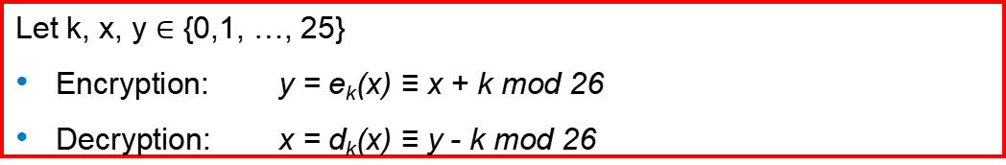
Shift (or Caesar) or Monoalphabetic Substitution Cipher (2)
Elegant mathematical description of the cipher.
Let k, x, y $∈$ {0,1, …, 25}
Encryption: y = e_{k}(x) ≡ x + k mod 26
Decryption: x = d_{k}(x) ≡ y - k mod 26
Q; Is the shift cipher secure?
A: No! several attacks are possible, including:
Exhaustive key search (key space is only 26!)
Letter frequency analysis, similar to attack against substitution cipher

Slide 48
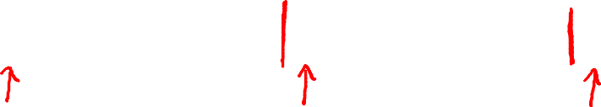
Vigenere cipher (16’th century, Rome) --A polyalphabetic substitution cipher
k = C R Y P T O
C R Y P T O
C R Y P T
(+ mod 26)
m = W H A T A N I C E D A Y T O D A Y
c = Z Z Z J U C L U D T U N W G C Q S
suppose most common = “H” first letter of key = “H” – “E” = “C”
Notes:
Explain how to break

Slide 49
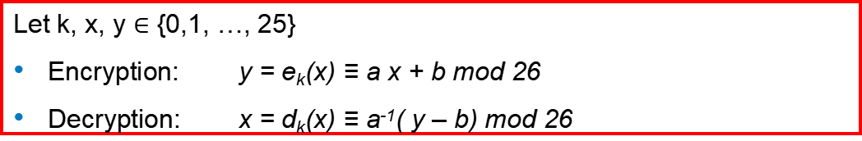
Affine Cipher (1)
Extension of the shift cipher: rather than just adding the key to the plaintext, we also multiply by the key
We use for this a key consisting of two parts: k = (a, b)
Let k, x, y $∈$ {0,1, …, 25}
Encryption: y = e_{k}(x) ≡ a x + b mod 26
Decryption: x = d_{k}(x) ≡ a⁻¹( y – b) mod 26
Since the inverse of a is needed for inversion, we can only use values for a for which:
gcd(a, 26) = 1
There are 12 values for a that fulfill this condition.
From this follows that the key space is only 12 x 26 = 312 （a:12 b:26）
Again, several attacks are possible, including:
Exhaustive key search and letter frequency analysis, similar to the attack against the substitution cipher

Slide 50
More about Classic Ciphers
Refer to Chapter 3 of textbook “Cryptography and Network Security”

Slide 51
Lessons Learned
Never ever develop your own crypto algorithm unless you have a team of experienced cryptanalysts checking your design.
Do not use unproven crypto algorithms or unproven protocols.
Attackers always look for the weakest point of a cryptosystem. For instance, a large key space by itself is no guarantee for a cipher being secure; the cipher might still be vulnerable against analytical attacks.
Key lengths for symmetric algorithms in order to thwart exhaustive key-search attacks:
64 bit: insecure except for data with extremely short-term value
128 bit: long-term security of several decades, unless quantum computers become available (quantum computers do not exist and perhaps never will)
256 bit: as above, but probably secure against attacks by quantum computers.
Modular arithmetic is a tool for expressing historical encryption schemes, such as the affine cipher, in a mathematically elegant way.

